Slide 1
Human activity recognition
Monirul Islam Mahmud 2011839042
Md Shihab Reza 1931229642
Hafeza Akter 1922175042

Slide 2
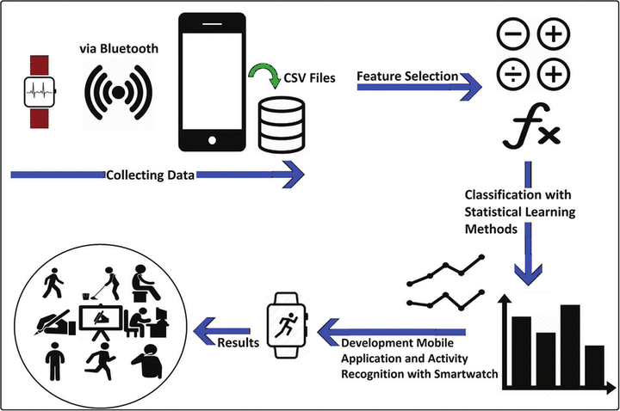
Introduction
Human Activity Recognition (HAR) is a key research area in AI, ML, and ubiquitous computing, focused on identifying and predicting human actions using sensor data.
This paper conducts a comprehensive analysis and comparison of machine learning techniques for HAR, aiming to understand and quantify the relative performance of four distinct models: Gradient Boosting, AdaBoost, KNN, and Voting Classifier.
The research evaluates the performance of these models in the context of HAR, using a consistent dataset for fair comparison of their performance metrics.
By analyzing accuracy, precision, recall, and F1 score, this study provides insights into the strengths and weaknesses of each model, aiding in the selection of the most suitable approach for HAR applications.

Slide 3







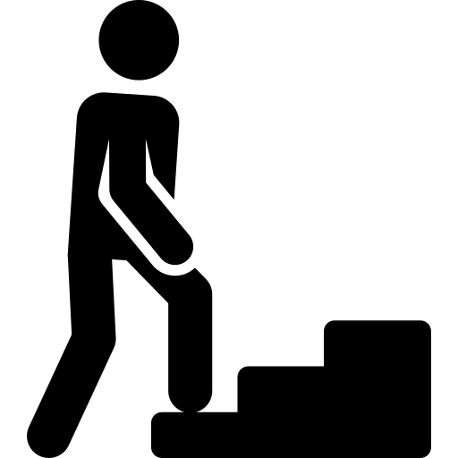



Work flow
Missing Value Analysis
Data Cleaning
Object to numerical conversion
CSV files
Data Collect
Preprocessing
Result
Classification with Supervised Machine Learning & Deep Learning method

Slide 4
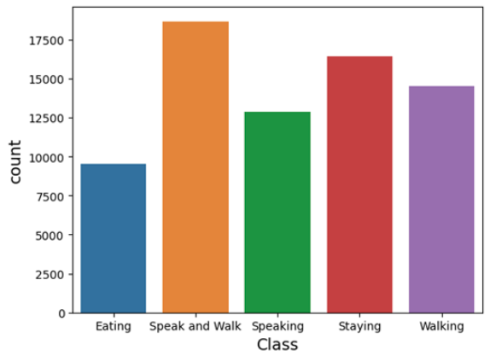
Dataset Details
The dataset consists of 72,094 rows and 7 columns, with one of the columns being the 'class' column, which plays a crucial role in classification tasks.
The 'class' column contains five distinct data classes, indicating different categories or labels assigned to each data instance.
Figure 1: graphical representation of the distribution of the data classes

Slide 5
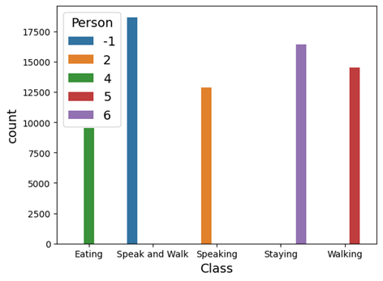
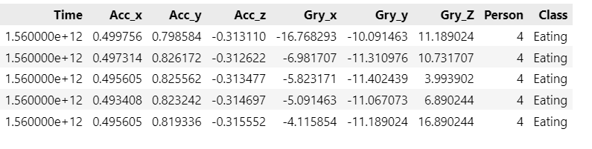
Dataset Details
Fig: Person wise activity data.

Slide 6

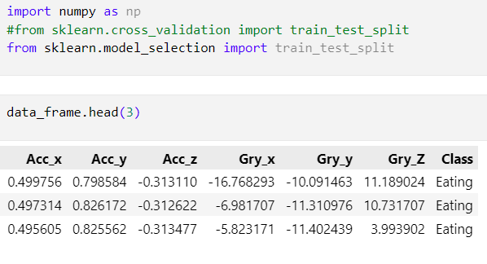
Drop Feature

Slide 7
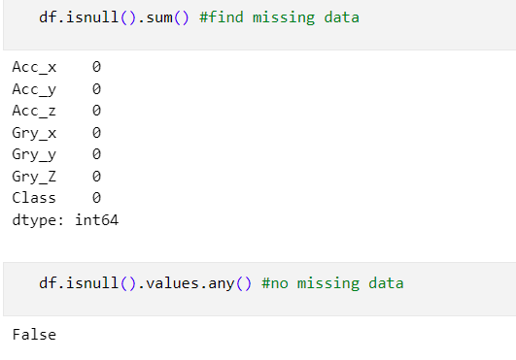
Null value handle
Missing values in the dataset were handled by dropping them during the data preprocessing stage. This ensures that the remaining data used for training the machine learning algorithms is complete and free of missing values.

Slide 8
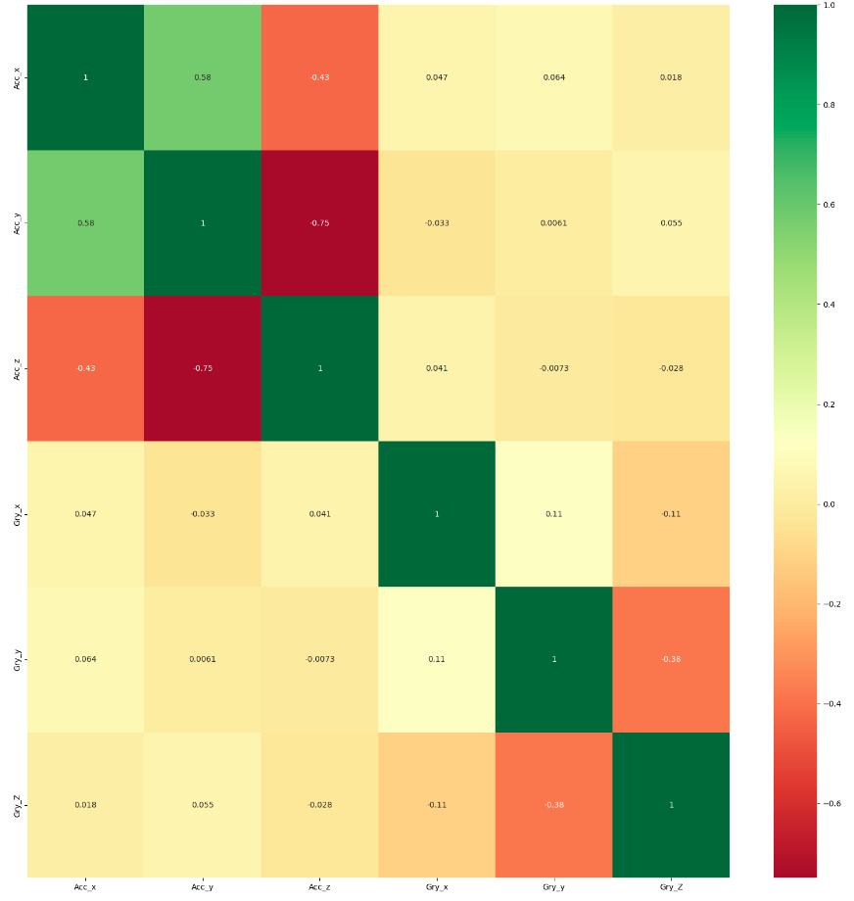
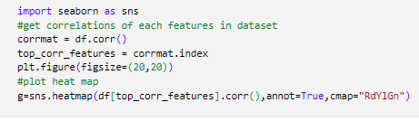
Correlation Matrix

Slide 9
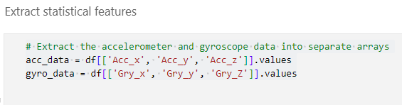
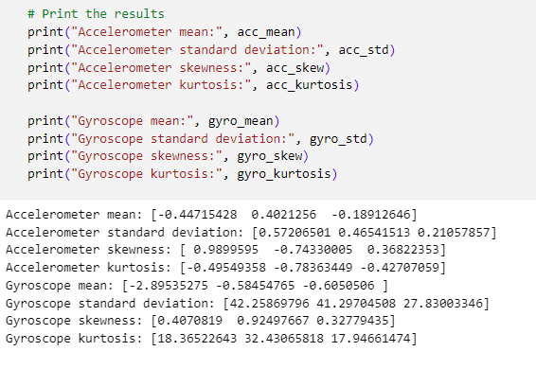
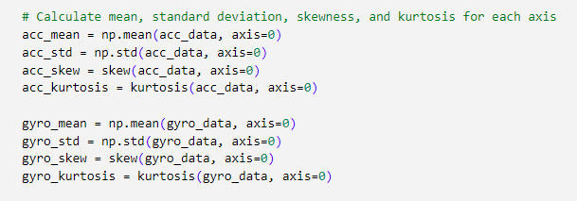
Statistical Feature Extract

Slide 10




ML Model
Support Vector Machine (SVM)
Random Forest Classifier
Gradient Boosting
Ada Boost Classifier
K-Nearest Neighbor
Voting Classifier

Slide 11
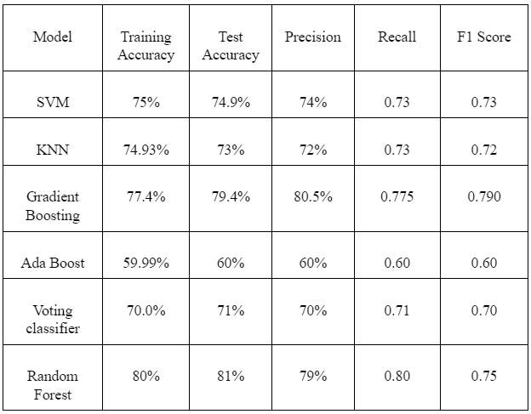
Result Analysis

Slide 12
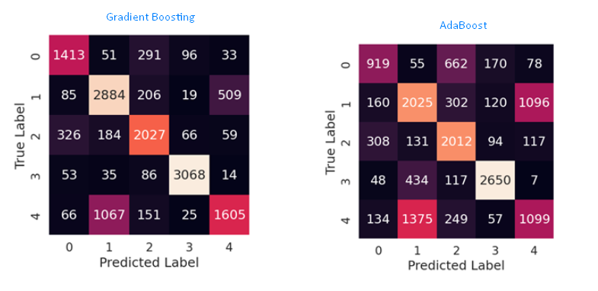
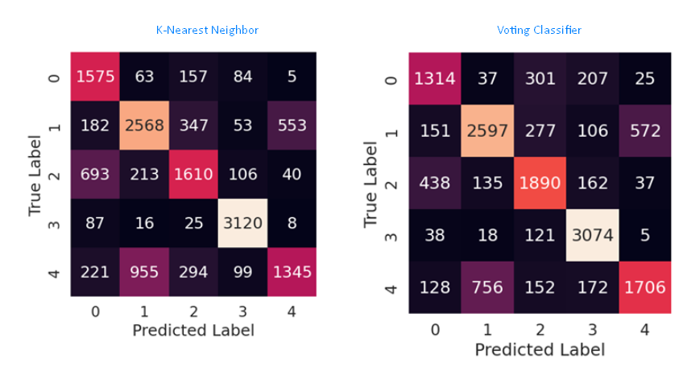
Confusion Matrix

Slide 13
Future Work
Employing feature engineering techniques to enhance performance by extracting more informative features from accelerometer and gyroscope data.
Exploring ensemble methods that combine multiple models can further improve the accuracy and robustness of human activity recognition.
Integrating advanced deep learning techniques, such as Convolutional Neural Networks (CNNs) or Artificial Neural Networks (ANNs)
Collecting more diverse and comprehensive datasets, and preprocessing them appropriately, is crucial for evaluating model performance in real-world scenarios.
Addressing class imbalance in the dataset and employing techniques like oversampling or under sampling can improve model performance and generalization.

Slide 14
Conclusion
The study emphasizes the significance of algorithm selection in human activity recognition tasks. The superior performance of the Gradient Boosting model showcases its potential for real-world applications.
Enhancing the effectiveness of the AdaBoost model should be a priority, as it exhibited lower performance in the study. This can be achieved through further research and improvements to ensure its efficacy in similar tasks.

